Slide 1
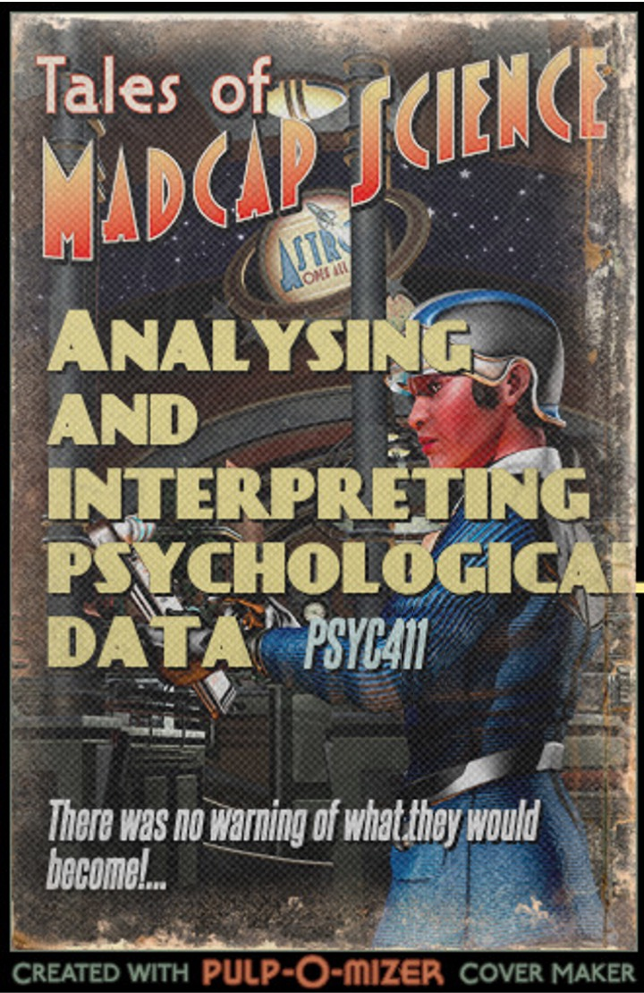
Tales of madcap science

Slide 2
Module outline
Week 1: Introducing data, introducing Rstudio
Week 2: Manipulating data, using Rstudio
Week 3: Exploring data and creating figures and graphs, using Rstudio
Week 4: Categorical data and the chi-squared test – testing random versus structured?
Week 5: t-tests – testing whether two groups are different
Week 6: Research report/analysis
Week 7: Measurement, hypotheses, associations (correlations)
Week 8: Predicting behaviour: the linear model
Week 9: Data visualisation
Week 10: Predicting behaviour: developing the linear model

Slide 3
Objectives for Week 2
By the end of this session, you should be able to:
Understand the importance of open data in psychology
Understand different types of data and how best to represent them
Understand bar graphs, scatter plots, and interpret patterns in these graphs
Open data sets in R-studio and manipulate those data
Use R-studio to make simple graphs

Slide 4
Rstudio and R: inputting data
We will practise inputting data, investigating data, and manipulating data
We will begin to look at a data set that we’ll return to next week
How many words do you know?
What factors predict how many words you know?

Slide 5
Rstudio and R: inputting data
Brysbaert (2016) provides a test of estimating people’s vocabulary
http://vocabulary.ugent.be/
We will have a go at this next week
For now, let’s look at two previous years’ PSYC401 students’ scores
The data is called PSYC401-shipley-scores-anonymous-17_18.csv, and I’ve downloaded it and put it in a folder on my computer called 401/week2
To load in the data, we have to put the data on our computer, and then load it in

Slide 6
Rstudio and R: inputting data
To load in the data, we have to put the data on our computer, and then load it in
Open Rstudio
It’s always a good idea to clear out Rstudio ready for a new session, to do this type at the console: rm(list=ls())
Next, we have to load in a library which contains the functions we are going to need

Slide 7
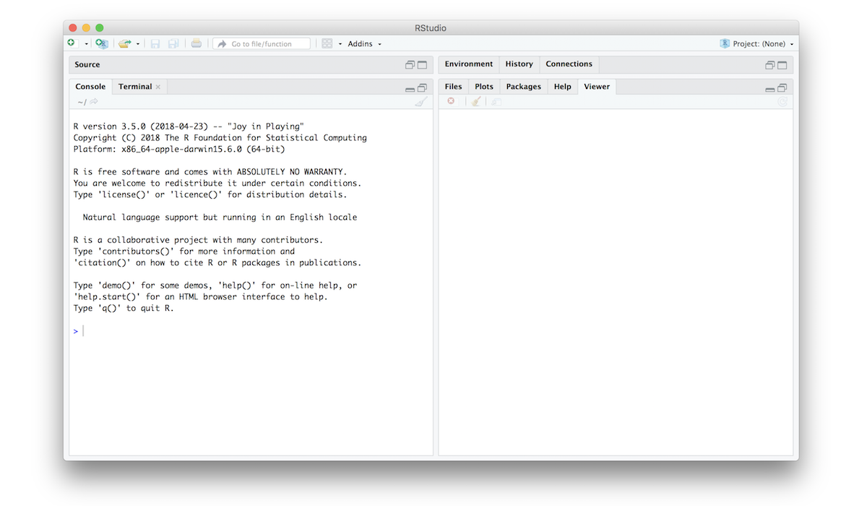
Rstudio and R
Let’s focus on the console
To input data and manipulate data, we need to use functions

Slide 8

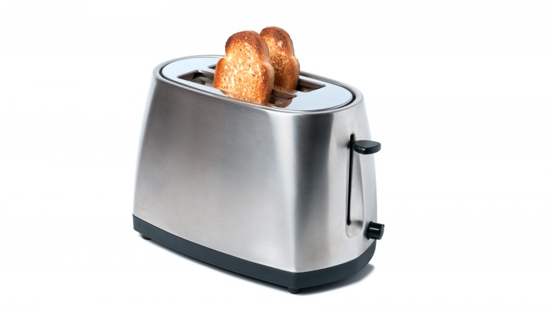

Rstudio and R: functions
From Glasgow University R for psychologists: ”A function is a tool that takes an input, performs some action, and gives an output. They are nothing more than that. If you think about it your toaster is a function: it takes bread as an input; it performs the action of heating it up; … and it gives an output, the toast.”

Slide 9
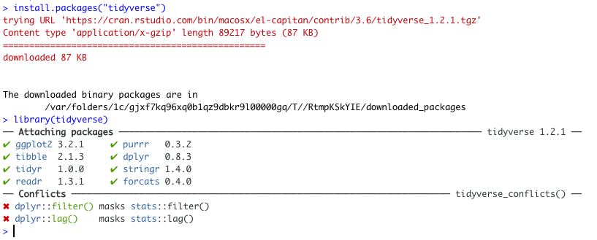
Rstudio and R: libraries
In Rstudio, functions are stored in libraries
To access certain functions we need to install certain libraries
We’ll install the “tidyverse” library.
At the console, type install.packages("tidyverse") and press return
note you have to type it exactly like this, including all the dots and the double-quotation marks
Then type library(tidyverse) and press return

Slide 10
Rstudio and R: libraries
In Rstudio, hopefully you only have to install packages once. But every time you open a Rstudio session you need to load in the library again.

Slide 11
Rstudio and R: inputting data
Next, we have to set the “working directory”, this tells Rstudio where to look for the data
Click “Session” in the menu at the top of the screen
select “Working directory”
select “Choose directory”.
Then, browse to the directory “PSYC401/week2” (or whatever you’ve called your folder), and click “Open”.
If it worked, in the console it should say something like setwd("M:/yourname/yourfiles/PSYC401/week2")

Slide 12
Rstudio and R: inputting data
Now we can open the file. The file is called PSYC401-shipley-scores-anonymous-17_18.csv
Each row is one person’s data, and each column is a measure taken from the person
Columns are separated by commas, which is what the “csv” refers to
We open csv files using a function called ”read.csv” in the console: dat <- read.csv("PSYC401-shipley-scores-anonymous-17_18.csv")
This means we put the data into the object “dat”

Slide 13
Rstudio and R: exploring data
If all went well, we can then look at the data, using the function “View”:
In the console type View(dat)
It should open a spreadsheet where we can see the data
Next, we just focus on two variables from the data:
subject_ID which is the participants’ anonymised number
Gent_1_score, which is the participants’ score on the Gent vocabulary test, the first time they had a go
We do this using the function “select”
in the console type: summarydat <- select(.data = dat, subject_ID, Gent_1_score)

Slide 14
Rstudio and R: exploring data
If all went well, we can then look at the data, using the function “View” again
Finally, let’s just have a quick look at these data
In the console type hist(summarydat$Gent_1_score)
This will draw a histogram of the Gent vocabulary scores. “summarydat$Gent_1_score” means that we look at the Gent_1_score variable from the summarydat data set – the ”$” indicates that this is a variable from the set.
What kind of pattern does the histogram show?

Slide 15
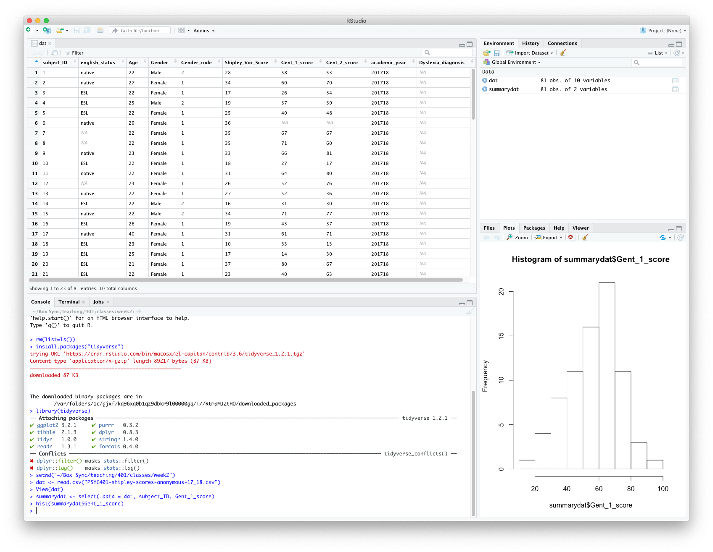
Rstudio and R: exploring data
If you’ve done it and nothing went wrong, you should see something like this in Rstudio:

